Slide 1
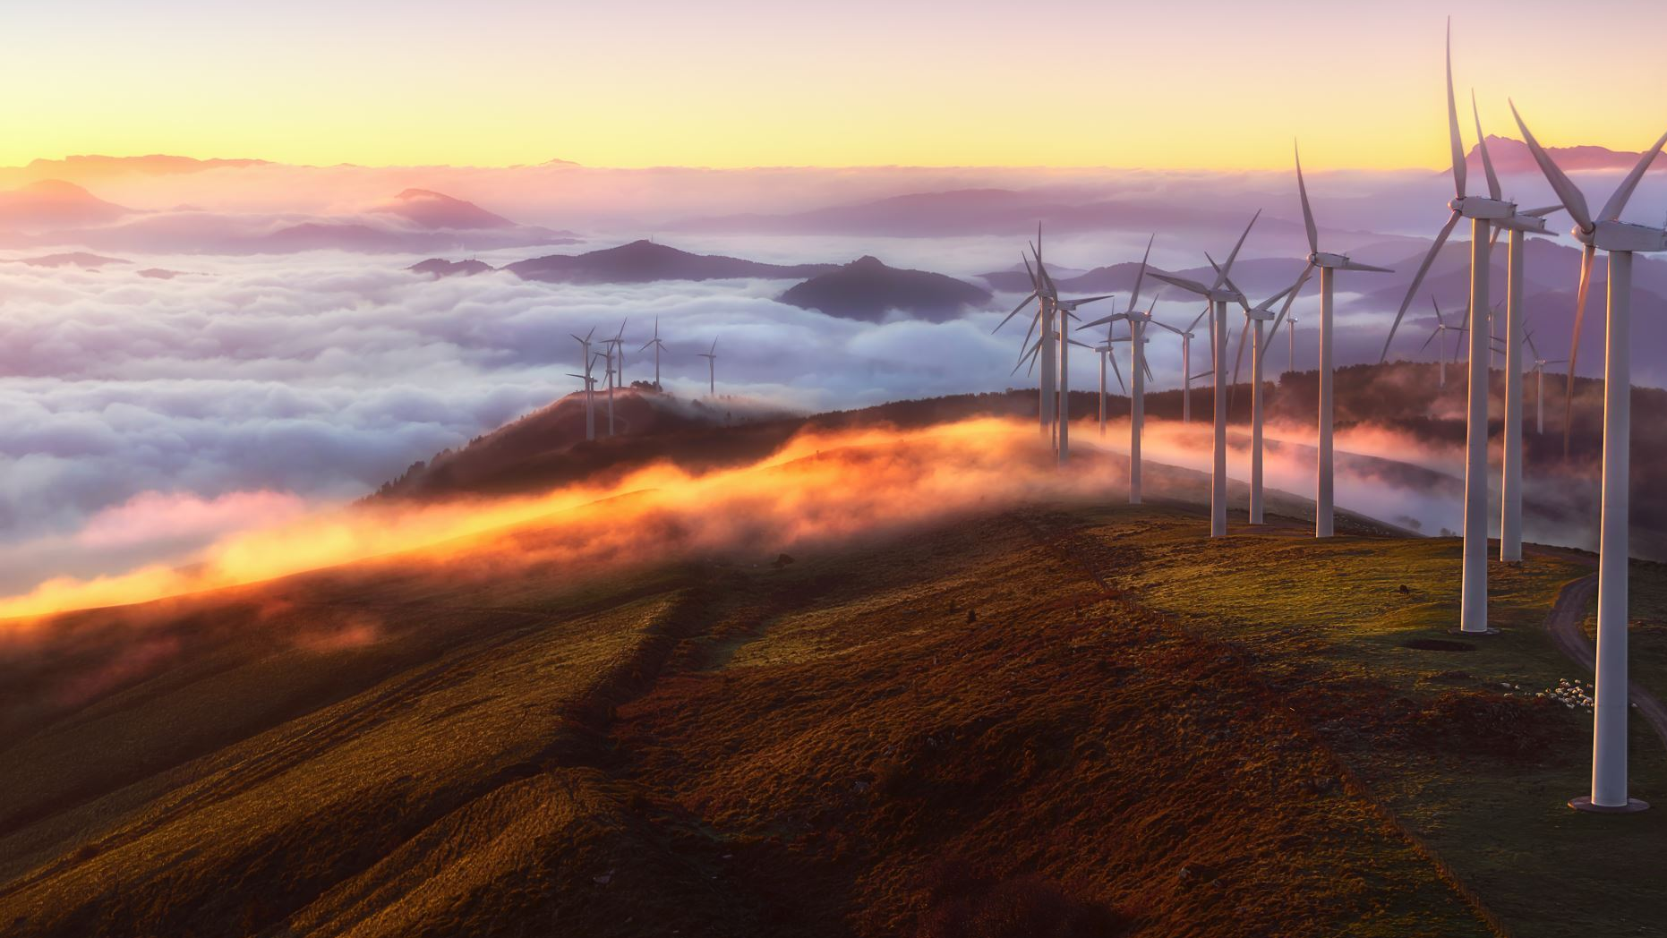
SKY VOLT
WIND ENERGY PERFORMANCE ANALYTICS SYSTEM
MENTOR : Anusha Vuggu

Slide 2

OVERVIEW
OBJECTIVE​
TECH STACK​
FULL STACK​
DATA SCIENCE​
INTEGRATION​
WORK FLOW​
LIMITATIONS​
FUTURE SCOPE​
CONCLUSION​

Slide 3
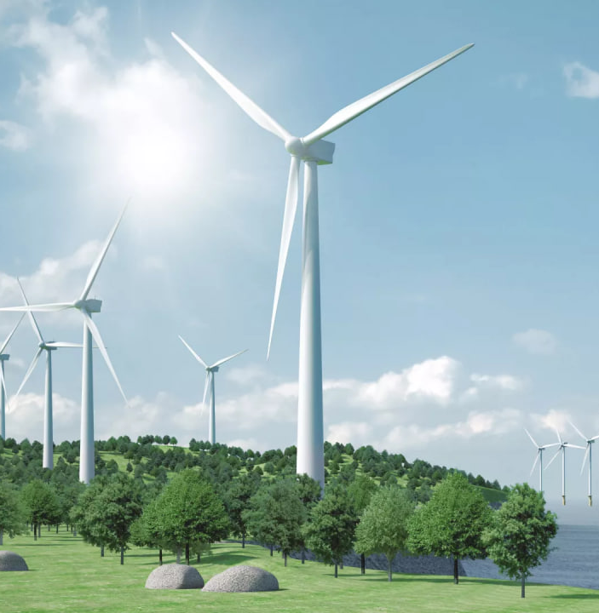
OBJECTIVE
The objective of this project is to design and develop an integrated web-based system for managing and analyzing wind energy–related information. The project aims to provide a centralized platform that presents details about wind energy installations, operational performance, user information, and cost trends in a clear and organized manner. By combining a website interface with analytical insights, the system helps stakeholders understand wind energy performance across different regions, sectors, and time periods. This project supports transparency, improves monitoring efficiency, and assists in informed decision-making for effective planning and management of wind energy resources.

Slide 4

TECH STACK
Programming Languages : Python, JavaScript
Visualisation : PowerBi
Web Framework : React
Frontend Technologies : React, css, Bootstrap, JavaScript
Development Tools : Kaggle, Jupyter Notebook, VS Code
Model Deployment : Agile / Iterative Development Model

Slide 5
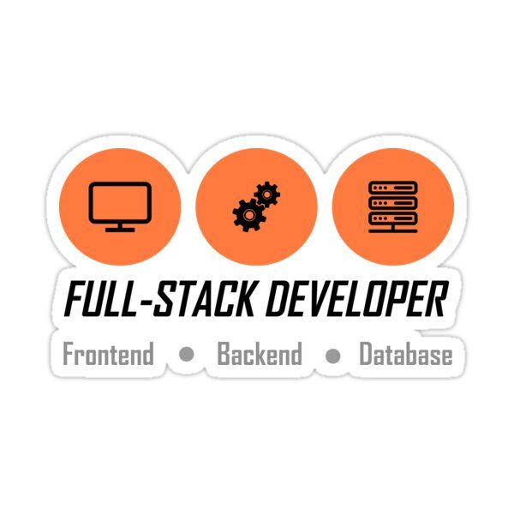
FULL STACK
Frontend is built using React, HTML, CSS, Bootstrap.
Backend is developed using Python / Node.js.
Database stores all wind plant and user information.
APIs connect frontend with backend.
Admin manages users and plants.
Users view dashboards and reports.

Slide 6
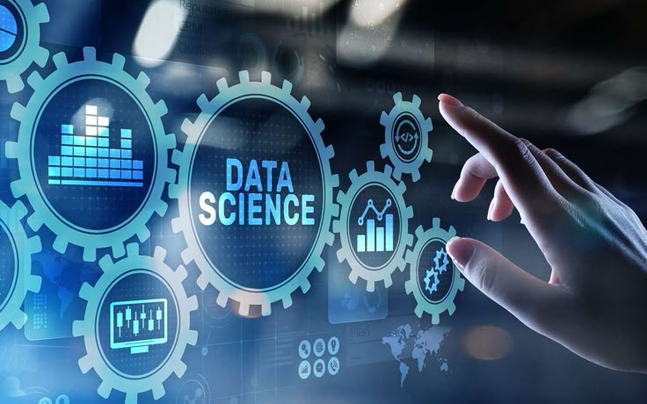
DATA SCIENCE
Collects wind power data from different sources.
Cleans and preprocesses the dataset using Python.
Uses Pandas and NumPy for data analysis.
Creates visual insights using Power BI.
Identifies patterns in wind speed and power output.
Helps in better decision-making using data.

Slide 7

FULL STACK AND DATA SCIENCE INTEGRATION
This project integrates data science and full stack development to deliver an end-to-end analytics system. Python is used for data collection, cleaning, preprocessing, and analysis, while Power BI is used for effective data visualization and dashboard creation. The frontend is developed using React, JavaScript, CSS, and Bootstrap to provide an interactive and user-friendly interface. Development and experimentation are carried out using tools such as Kaggle, Jupyter Notebook, and VS Code. The system is built and deployed using an Agile / Iterative development model, ensuring continuous improvement, smooth integration, and efficient delivery of insights.

Slide 8
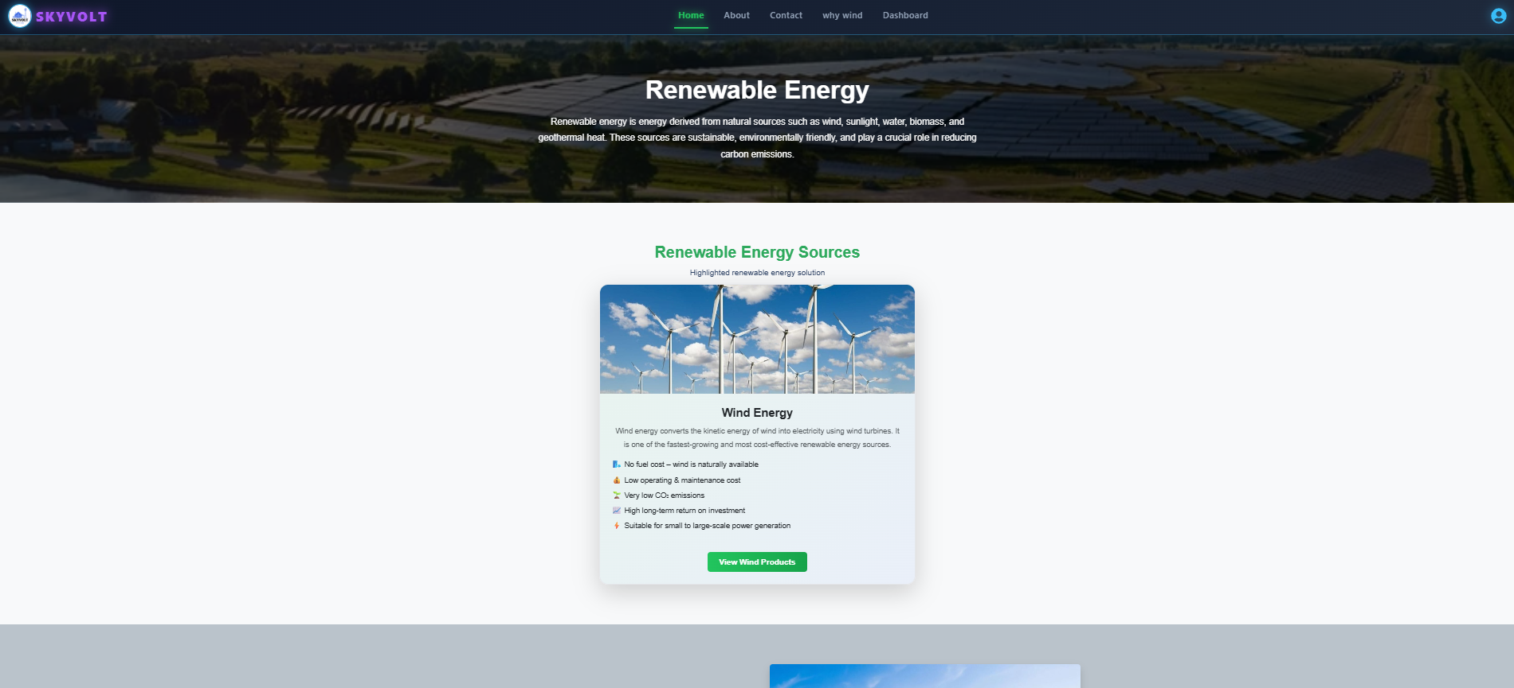
HOME PAGE

Slide 9
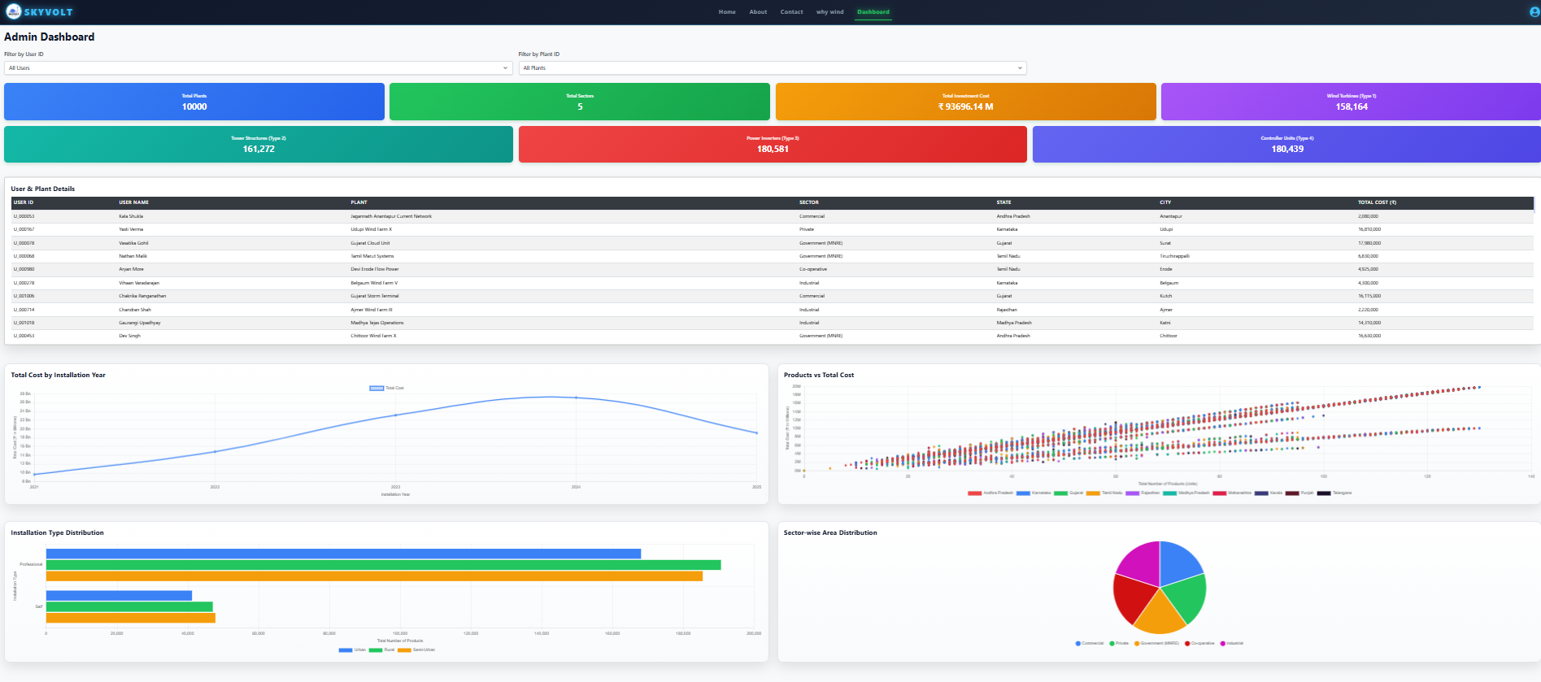
ADMIN DASHBOARD

Slide 10
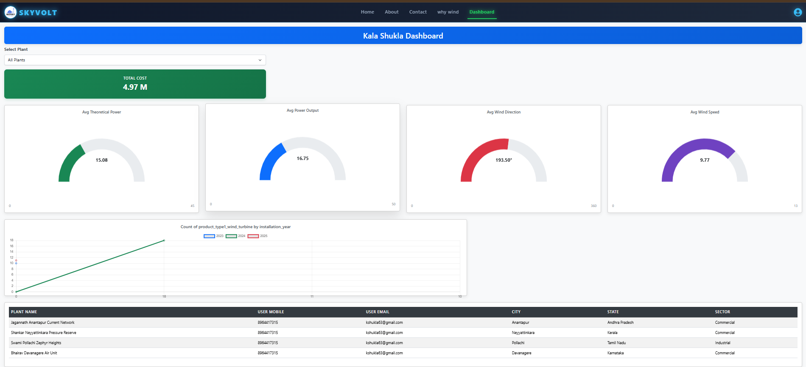
USER DASHBOARD

Slide 11
WORKFLOW
Data collection and cleaning
Feature engineering
Data analysis
Visualization and real-time detection
Results display using frontend dashboards

Slide 12
LIMITATIONS
The system depends on the availability and accuracy of input data, and incorrect or incomplete data may affect analysis results.
Real-time data updates are limited, as the project primarily works on pre-collected or periodically updated data.
The analysis is restricted to the selected parameters and regions included in the dataset.
Advanced forecasting and predictive analysis are not fully implemented in the current version of the project.
User access and functionality are limited to the features designed in the current system, with scope for further enhancements.

Slide 13
FUTURE SCOPE
Growing Demand and Environmental Benefits: Wind energy is expanding due to the rising global demand for clean and renewable energy, helping reduce greenhouse gas emissions, mitigate climate change, and improve national energy security by lowering fuel imports.
1
Technological Advancements and Integration: Improvements in wind turbine efficiency, offshore and floating wind technologies, AI-based wind forecasting, smart grids, and hybrid systems combining wind, solar, and energy storage have increased power generation and grid stability.
2
Economic Growth and Policy Support: Supportive government policies, reduced cost of wind power generation, and increased public and private investments are driving large-scale deployment, creating employment in manufacturing, installation, and maintenance sectors.
3

Slide 14
CONCLUSION
This project shows how full stack development and data analysis can be combined to build a wind energy performance system. The website and dashboards help admin and users view plant details, costs, and other important information in a clear way. By analyzing the dataset, the system helps in better monitoring and understanding of wind energy data. Even though the data is limited and not real-time, the project creates a strong base for future profit analysis, real-time tracking, and better decision-making. Overall, the project shows how data analysis and web technology can help manage renewable energy resources effectively.

Slide 15

DONE BY:
DATA SCIENCE TEAM
FULLSTACK TEAM
K. Lalitha
U. Raj Kumar
M. V. Satya Hemanth
Sachin Sanap
Lakshmi Deepika
Rama Krishna
Deepthi

Slide 16


